Slide 1
Cs-381 Software Engineering
Course Instructor: Dr. Shazia Arshad
Notes:
Welcome to all of you in this course. I am Dr. Shazia Arshad. I will be your instructor for this course.

Slide 2
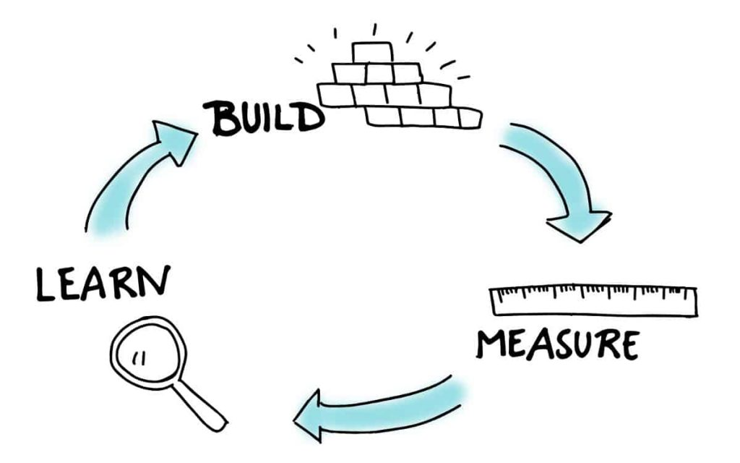
SOFTWARE DEVELOPMENT LOOP
Notes:
As with construction of every other product there involves CONTINUOUS LEARING, then BUILDING and MEASURING the product to find defects or flaws.
What is meant by Software Development Loop?
It consists of serious of steps which are repeated again and again.
The major steps include can be classified into 4 categories:
Problem Definition ( what is the problem against which we are going to develop software? )
Technical Development (development of the project)
Solution Integration (combine it with existing solution explanation in next slide)
Status Quo (Status quo “represents the current state of affairs”)
The loop continue to work.

Slide 3

PAYROLL SOFTWARE
Notes:
To understand the concept of WHAT IS SOFTWARE INTEGRATION, lets take an example of payroll software.
You are required to develop a PAYROLL SYSTEM. For this, you need to know if the company have EXISTING ACCOUNTING SOFTWARE or not.
if the Accounting System do not exist, then it becomes difficult to deal with information.
Consider the case, where you need information from both systems (Accounting and Payroll) and the systems are separated.
For example, if you wants to get STATUS of any worker, if the worker gains provident fund and loan or not.
How do you managed to get this information??
After integration, the system works perfectly. Now, it is required to develop a system of Automated Time Keeping or Time Log. The system will record the time that when a worker comes in the office and when does he leaves the office. So, this is a NEW PROBLEM DEFINITION and from here the loop begins again.

Slide 4

A software Engineering Framework
Notes:
What is a FRAMEWORK?
A framework is something that gives programmers most of the basic building blocks they need to make an app.
Example of a framework:
An example of a framework is an outline created before writing an essay.
Why framework is necessary??
Lets understand this with the help of an example.
Imagine you’re cooking dish for 20 people. You’re going to need an oven, a stove, a fridge, a sink, probably hundreds of ingredients, utensils, plates – etc. etc.
A framework is like a fully stocked kitchen. It has all of these things ready for you to cook with. You just need to work out what to make with it all!
Software frameworks may include support programs, compilers, code libraries, tool sets, and application programming interfafce (API's) that bring together all the different components to enable development of a project.

Slide 5

LAYERED TECHNOLOGY
Notes:
Software engineering is a layered technology.
The layers are related to each other and to develop software one will have to go from one layer to another.
The layers in a Layered Technology are fundamental and can’t be skipped.

Slide 6

Quality Focus Layer
Notes:
The first layer is called Quality Focus.
In every organization, quality is the top most priority. Every product of engineering is designed keeping Quality in mind.
Quality makes sure that the product created will meet the standards and will not disappoint the client.

Slide 7
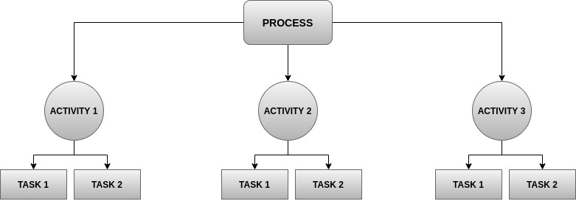
Process Layer
Notes:
The foundation for software engineering is the process layer.
A process defines WHO is doing WHAT , WHEN and HOW to reach a certain goal.
Process defines a framework for a set of Key Process Areas that must be performed.
It defines the task to be performed and the order in which they were to be performed.
From the figure (in slides) it can be seen that the process is divided into set of activities to be performed. The activities are classified as follows:
Software Analysis
Software Design
Software Implementation
Software Testing
Software Deployment
Software Maintenance
Each activity is assigned to a one group or a team. The team is then responsible for the completion of this activity. Within the team, the activity is further divided into different tasks. Each member is assigned a task to be performed. For example, the Tasks for analysis phase are classified as:
Requirement Elicitation
Requirement Prioritization
Requirement Specification

Slide 8
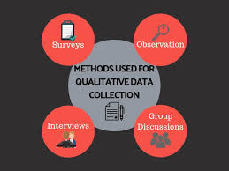
METHODS & TOOLS
Notes:
The next layer is Method layer.
This layer defines that HOW TO COMPLETE A TASK?
To achieve any task, we have different methods.
For example, the different methods used for Requirement Gathering includes:
Taking Interviews
Conducting Surveys
Having Group Discussions
Observation
The last layer is TOOLS.
It includes the tools and technologies used to achieve a task.

Slide 9
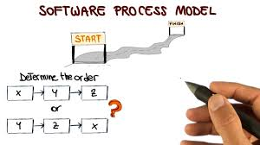
SOFTWARE PROCESS MODEL
Notes:
What is software process model?
A software process model represents the order in which the activities of software development will be undertaken. It describes the sequence in which the phases of the software lifecycle will be performed.
There are many different software processes models, but all involve:
Specification – defining what the system should do.
Design and implementation – defining the organization of the system and implementing the system.
Validation – checking that it does what the customer wants.
Evolution – changing the system in response to changing customer needs.
How to choose model for a project?
A process model for software engineering is chosen based on
the nature of the project and application,
the methods and tools to be used,
and the controls
and deliverables that are required.

Slide 10
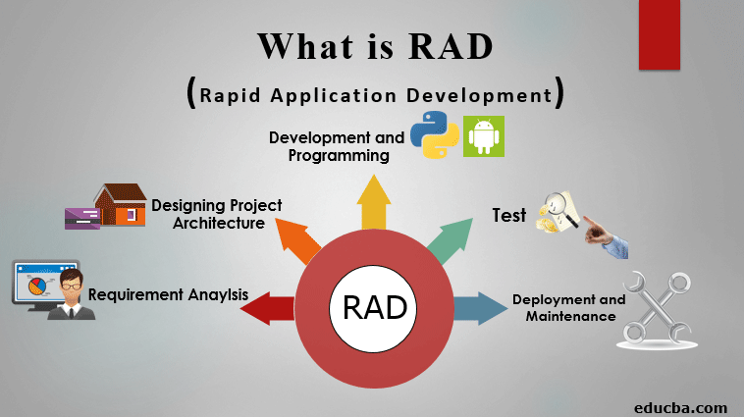
RAPID APPLICATION DEVELOPMENT
Type of incremental model.
Rapid prototyping and iterative delivery.
The components or functions are developed in parallel as if they were mini projects.
Notes:
How long does it take to create a software application?
If you think of all the elements associated with the software development life cycle (SDLC) - conducting a needs analysis and planning, defining the requirements (what do we want the software to do), developing the software code, testing the software, and then finally deploying it to the end user - this process can take months, if not years from start to finish.
But what if you don't have months or years?
What if you need to get your software out there now while the need for it is hot and there is a market for it?
In this case, you will use RAD.
When to use RAD??
Need to develop in a short time span (2-3 months)
If there’s high availability of designers for modeling
If resources with high business knowledge are available
Example:
Employee Resignation System:
HR will be leading the charge on this development.
Need input from management, payroll, IT, and many others.
RAD can play a key role in quickly adding steps to your workflow and testing to make sure that confidential data is hidden from those who don’t need to see it.
HR team may also want to handle resignations and terminations in the same application.

Slide 11
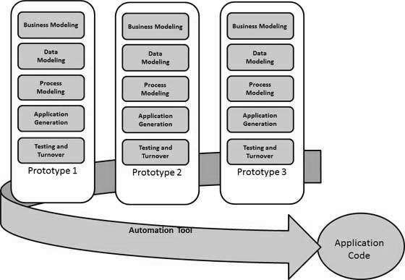
RAD MODEL
Notes:
How does the RAD model works??
Basic principle is to divide tasks into teams.
Working of RAD model can be classified into 5 steps.
Business Modelling: gathering information from stakeholders and finalize requirements such as project goals, expectations, timelines, and budget.
Data Modelling: information gathered during the Business Modeling phase analyzed, the information is grouped into different groups.
Process Modelling: Changes are done and any descriptions for adding, removing, or changing the data objects are also created during this phase.
Application Generataion: all the information gathered is coded, and the system that is going to be used to create the prototype is built.
Testing: The prototypes are independently tested after each iteration. The data flow and the interfaces between all the components are fully tested.

Slide 12

Benefits / Limitations
Notes:
What are the pros and cons of using RAD model?
Benefits:
Enhanced flexibility and adaptability
reduce development time
speed up delivery
Encouragement of code reuse
Increased customer satisfaction
Fewer surprises
Limitations:
Not suitable for large projects
Requires highly skilled developers
Feedback from user is required at every stage
Strong team work and individual performance.

Slide 13

TIME TO THINK
List down ten factors used for choosing software process model ????
For using RAD model, budget should be high. Why?
Notes:
So, its time to check if you are active or not???
List down ten factors used for choosing software process model ????
For using RAD model, budget should be high. Why?

Slide 14

Time tO Answer
Notes:
Before you choose a methodology for your software development, there are a lot of factors you
need to consider. Some of these include:
1. The requirements for the project: Each software development project consists of requirements that must be met before it’s implemented. So, you have to evaluate these requirements and compare them to what you have in place in your company, before choosing a methodology. That way, you’ll be able to arrive at the best methodology to use at all times and choose a system that will give you the best results for the resources and time spent.
2. The expected end product of the project: Before starting a software development project, you need to have an end product in mind. This is the result that you hope to achieve after completing the project. You must envision this and sketch it out in the software design phase before the first line of code is written.
3. The past experience of the project team with the methodology: The experience of the software development team in your company matters too. This should be considered when deciding on the software development methodology you want to use. Some team members may not feel comfortable working with certain systems if they don’t have any prior experience with them, while others might find it difficult getting used to working with new team members. It’s important to keep team capabilities and team dynamics in mind.
4. Feedback on the work done: Feedback is a crucial aspect of software development. It helps you formulate outcomes for future projects. As a matter of fact, if you don’t know exactly how you arrived at previous results, you won’t be able to replicate them. While doing this, you need to consider how efficient your team is in providing feedback. This depends largely on the applications, methodologies, and the size of the project.
5. Project size: Before picking a software development methodology to use, you need to consider the size of the project you’re embarking on. While larger projects may not fit perfectly for the waterfall, some apps will require longer testing times owing to their size and requirements.

